Slide 1
Home sweet Home? Not for everyone!
Lynn, Fien, Amber

Slide 2
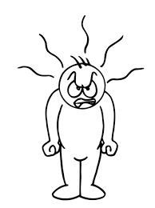

Covid-19 …. eeeuurrghhhhh!!!!

Slide 3
What are we going to talk about?
Covid-19 measures
Some statements to think about
Organisations for the youth
School + tips and tricks
Is it all negative?

Slide 4
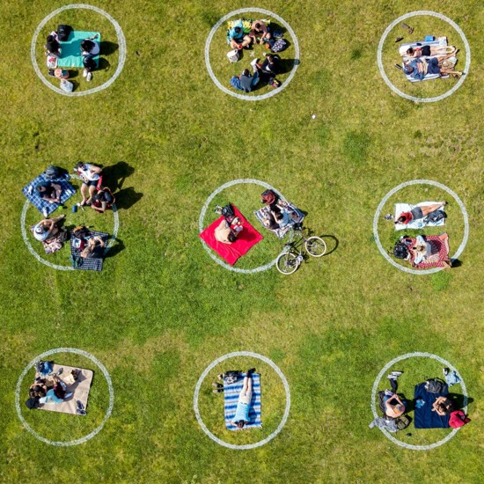
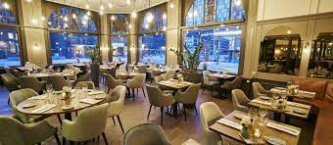
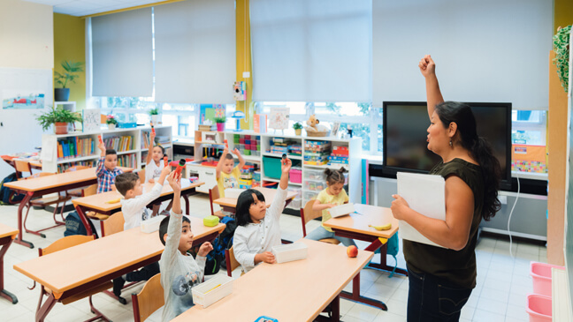
The most drastic measures in Belgium

Slide 5


Let’s discuss...

Slide 6
“Covid-measures affects every family equally”

Slide 7
“Covid-measures affects people in the countryside the same way as people in the city.”

Slide 8
“I think there is enough being done for the mental health during the pandemic”

Slide 9








Organisations

Slide 10
What about the schools?
Notes:
Now we are going to talk about the schools in times of Covid and what consequences it brought

Slide 11
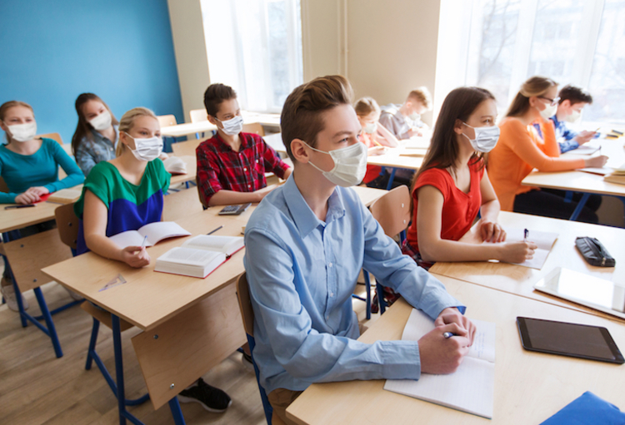
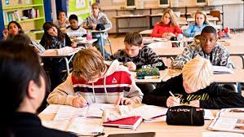
Before and after
Notes:
In Belgium, face masks must only be worn from the age of 12 years. For the students who are just starting high school, it's weird because they only half get to know everyone because half the face is covered.
Because the schools have been closed, there has been a lot of learning difficulty. Students have to do a lot on an independent basis and that's not easy for everyone. The longer this situation is going to continue, the worse the backlog will become. Students need the support and hopefully they can get it soon.
At school, under normal circumstances, there is plenty of opportunity for social contact. Today we have to keep our distance from everyone so that is less. After school, we would go shopping, drinking,... but that too is falling away.

Slide 12

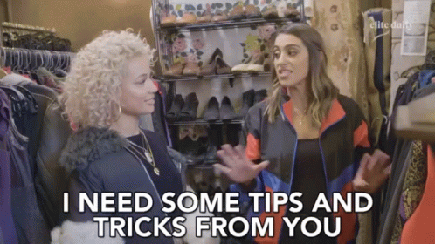
Tips & tricks for teachers and youth workers
Notes:
Because there is little social contact, young people may have somber thoughts.
There is a magazine named Klasse, and in November they published an article with tips and tricks for teachers for this difficult time. There are tips for the whole class and for students who have some extra difficulties.
Radiate calmness yourself to your students
Appreciate their efforts against Covid
Provide adequate feedback in distance learning
…
It is important that students are well supported so that they do not suffer further.

Slide 13
Courage and innovation
Notes:
Fien

Slide 14

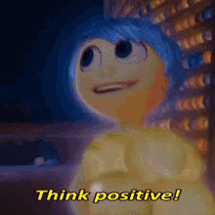
Is it all negative?
Notes:
Fien

Slide 15

“Can you think of anything positive in your life that happened because of COVID?”
Notes:
Fien: whitboard

Slide 16



